Slide 1
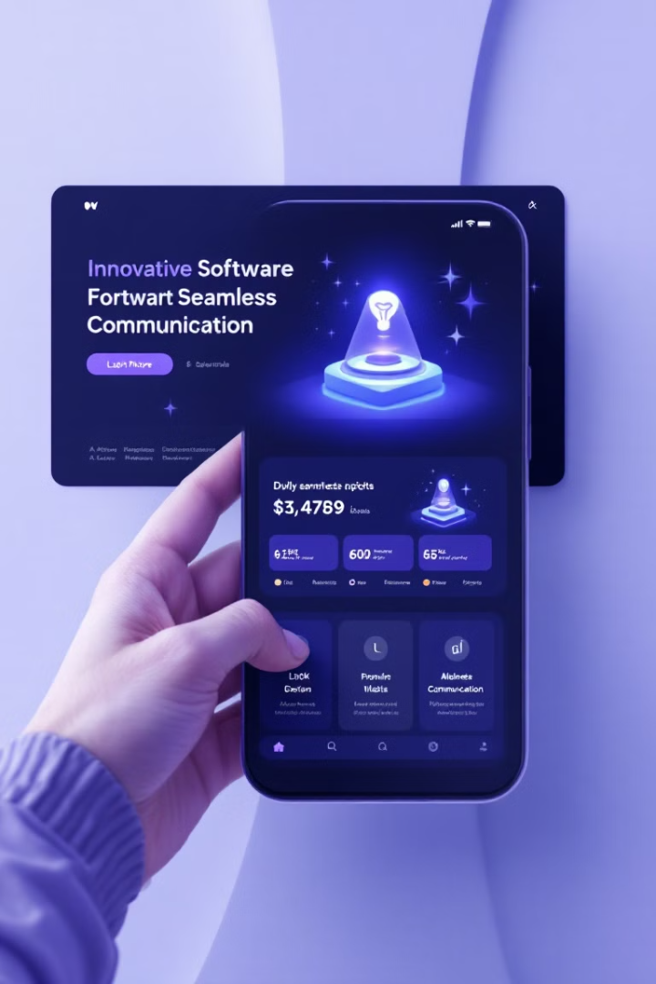
CommUnity QR: Enhancing Delivery Communication
CommUnity QR revolutionizes delivery services with a comprehensive platform that bridges communication gaps. Our solution integrates QR codes and real-time translation to ensure enhanced security and customer satisfaction.
The platform provides a seamless experience for both customers and delivery personnel. Customers can track their orders and receive real-time updates on delivery status, while delivery personnel can scan the QR code to access complete order details. With CommUnity QR, we're raising the bar for delivery communication.

Slide 2




CommUnity QR: Our Team
M NIRANJAN
KEERTHAN P.V
MANOJ R
PES2UG23CS308
PES2UG23CS272
PES2UG23CS328

Slide 3

Key Issues Faced by Delivery Services
1
Language Barriers
2
Security Concerns
Miscommunication arises due to diverse languages, causing delivery delays and customer frustration.
Lack of secure identity verification raises trust issues among customers and delivery personnel.
3
Customer Dissatisfaction
Inadequate delivery communication results in poor customer experiences and increased complaints.

Slide 4

CommUnity QR’s Value Proposition
CommUnity QR empowers delivery services with a robust communication platform that addresses critical challenges and fosters a seamless experience for all stakeholders. Through the integration of QR code technology and real-time translation, we aim to bridge language barriers, enhance security, and optimize customer satisfaction.
Our platform facilitates clear and efficient communication between delivery personnel and customers, regardless of language differences. Real-time translation eliminates communication hurdles, ensuring accurate order details and timely delivery updates.
CommUnity QR prioritizes security by offering visual and verbal confirmations for each delivery step. This fosters trust and transparency throughout the delivery process, safeguarding both customers and delivery personnel.
By providing a multilingual and user-friendly platform, CommUnity QR delivers a seamless customer experience. This fosters customer loyalty and strengthens brand reputation within the delivery sector. Through innovative technology and a customer-centric approach, we strive to revolutionize the delivery landscape and create a more efficient, secure, and enjoyable experience for all.

Slide 5

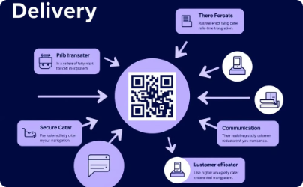
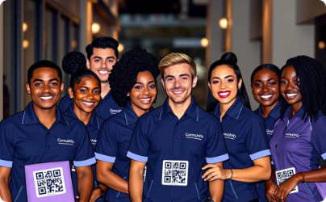
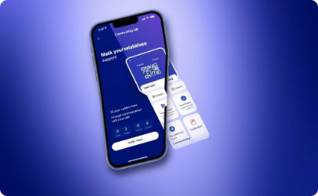
Strategic Product Positioning
Target Market
Competitive Edge
Brand Image
Value Proposition
CommUnity QR targets e-commerce and logistics businesses in multilingual cities. Our focus is on businesses of all sizes, aiming to improve delivery efficiency in diverse urban areas.
CommUnity QR combines QR code technology, real-time translation, and secure video calls to address key challenges in delivery services. This creates a seamless and secure experience for customers and delivery personnel, enhancing efficiency and trust.
CommUnity QR aims to be a trusted and reliable solution that promotes transparency, security, and inclusivity in global deliveries. We bridge communication gaps and improve the delivery experience for everyone involved.
CommUnity QR offers a multilingual platform for a seamless customer experience, fostering loyalty and strengthening brand reputation. Our innovative technology and customer-centric approach revolutionize the delivery landscape, creating a more efficient, secure, and enjoyable experience for all.

Slide 6




Operational Organization and Growth
Development Team
Customer Service
Business Development
Data Analytics
Focus on app and translation technology advancement.
Dedicated support to address user inquiries efficiently.
Forge partnerships with e-commerce and logistics entities.
Analyze data for service optimization and strategic insights.

Slide 7
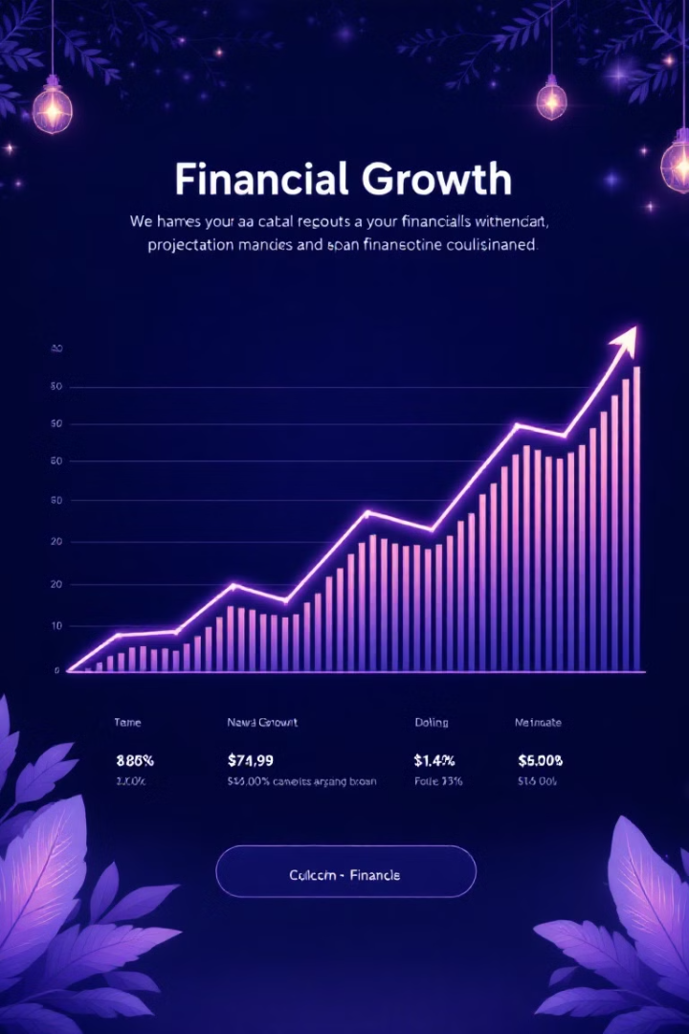
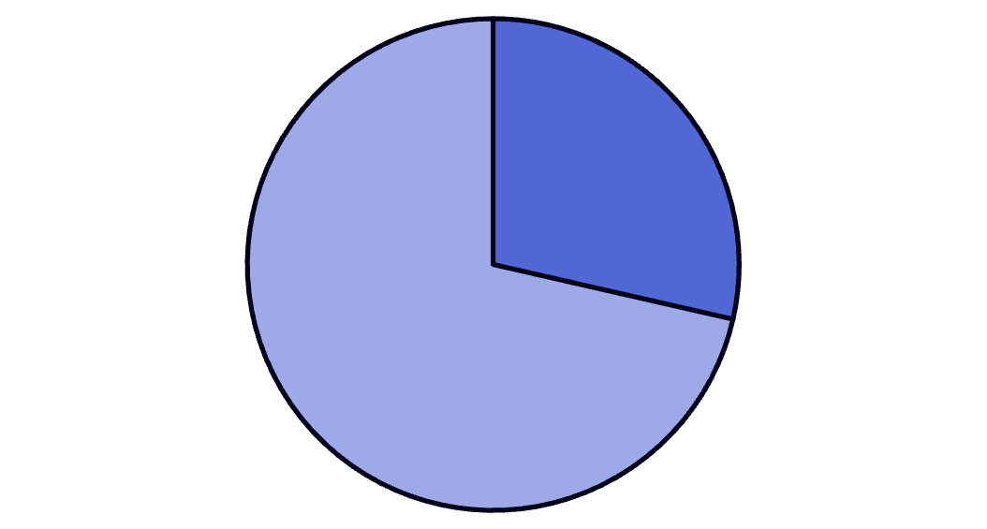
Financial Planning: Four-Year Profit and Loss
Year 1
Initial deployment costs, expected net loss.
Year 2
Rising adoption leads to breakeven.
Year 3
Continued growth, revenue surpassing costs.
Year 4
Profitability with a 15-20% margin.
2024
2025
2026
2027

Slide 8
Financial Planning: Four-Year Profit and Loss
Year
Funding
Revenue
COGS
Gross Profit
Operating Expenses (Salaries)
2024
15000
20000
6000
14000
5000
2025
5000
35000
10000
25000
7000
2026
0
50000
13000
37000
9000
2027
0
70000
17000
53000
12000
You can find a more detailed breakdown of these numbers in the attached Excel file.
The projected financial plan shows a significant increase in revenue over the four-year period. The company is expected to reach profitability by year 3 and sustain a 15-20% profit margin by year 4. The model accounts for funding, COGS, and operating expenses.

Slide 9



Funding Plan and Expansion Pitch
Technological Development
Market Expansion
Partnerships
Investment sought for AI and security advancements.
Funding to penetrate e-commerce-heavy regions.
Resources needed to expand collaborations with delivery entities.

Slide 10




Innovative Tools for Strategic Insights
Dynamic Presentations
Leverage Beautiful.ai and Tome for impactful visual content creation.
Detailed Financial Models
Use ChatGPT (Excel Code Interpreter) or Excel Formula Bot for precise P&L planning.
Content Streamlining
Optimize processes allowing content to fit presentation parameters perfectly.

